Slide 1


BANK MANAGEMENT SYSYTEM
Project Guide : Dr.R.Sathyabama Krishna
M.E., Ph.D.,
Student Name : Anisetti Sidhartha
[reg.no 38110531]

Slide 2
Presentation Outline
Introduction
Objective
Abstract
Problem Statement
Software and Hardware Specifications
Modules Description
Results and Discussion
Conclusion
Application Snapshots
References

Slide 3
Introduction
Bank Management System a simple console based system very easy to understand and use.
Talking about the system, it contains all the basic functions which include creating a new account, view account holders record, withdraws and deposit amount, balance inquiry, closing an account and edit account details.

Slide 4
Objective
To design and generate a Bank Management System, in order to enter the applicant information about his or bank account and can perform other functions like deposit , withdraw, also it is user name and ID protected.

Slide 5
Abstract
Bank Management System is an application for maintaining a person‘s account in bank. In this project I tried to show the working of a bank system and cover the basic functionality of a Bank Management System.
The Main Aim of this project ―Bank Management system‖ is to provide the simplest management of bank account and transaction between users and bank system. . In short, this projects mainly focus on CRUD (Create, Read, Update, Delete).This project is written in Python Programming Language. The project file contains a python script and a database file.

Slide 6
Problem Statement
The Bank Management System is an application for maintaining a person's account in a bank. Organization need to effectively define and manage requirements to ensure they are meeting needs of the customer, So here we try to create simple banking environment for users which includes all the basic bank functionalities.

Slide 7
Software And Hardware Specifications
It does not need any additional hardware of software to operate the program, but the following requirements should be strongly maintained.
Hardware Requirements:
Pentium ⅱ or above hardware.
512MB of RAM or higher.
800MHz processor or above.
20mb of hard disk space.
Software Requirements:
Operating system WINDOWS 98 or higher.
Anaconda distribution environment/ Jupyter notebook or any other editor to run python program.

Slide 8
Modules Description
3 external libraries used developing developing the code they are:
pathlib — Object-oriented filesystem paths
This module offers classes representing filesystem paths with sem
anticsappropriate for different operating systems.
os — Miscellaneous operating system interfaces
This module provides a portable way of using operating system dependent
functionality.
pickle :
In Python, you can use pickle to serialize (deserialize) an object structure into (from) a byte stream. Here are best practices for secure Python pickling.

Slide 9
Functions written to perform fuctionalities of the system are :
intro: This module is used to present the introduction screen, and take input
From the user to specific operation to be performed by the program.
WriteAccountsFile : This module is used to create new account of user by
Taking in account holder name, account number, type: savings/current,
Deposit amount. And save it in “accounts.data” file.
displayAll : This module is used to display all the existing user accounts details
displaySp : This module is used display the account details of the particular
Account holders by taking in account holders account number
depositAndWithdraw : This module is used to withdraw and deposit amount From/to the users account.
deleteAccount : This module is used to close an existing account from the accounts.data data file by taking in the users account number.
modifyAccount : This module is used change user account name, if there is any mistake or if you wish to. The changes will be permanent.

Slide 10
Developing the program source code for this project involves creating various modules/functions using basic python syntax, for different bank functioning like Creating account, Depositing amount, Withdraw of money, Viewing account balance, Displaying users account details, Modifying account details, Closing an account.
To save the user account details and transactions an external database connection file used in this project to save user’s data permanently. This database is built using external Python libraries pathlib, os. pickle library is used for serializing and deserializing data.
The to show main menu on the screen to user for choosing their required functions by simply selecting a the function. It is developed using switch case.

Slide 11
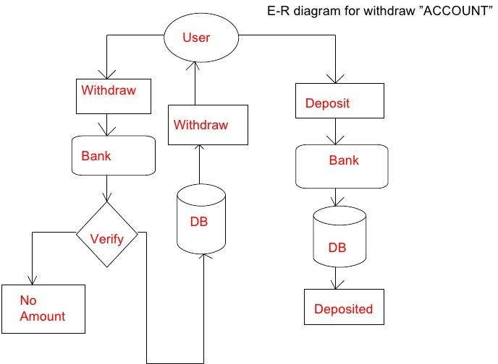
System Architecture
Architecture diagram for withdraw and deposit functions

Slide 12
Results And Discussion
The Project is very easy to understand and use. The major objective for this project is to create a simple interface between user and bank management system so that user can understand how e-banking works.
Every module in developing the project are working successfully and the external modules we imported for creating database to store the data also working efficiently. There is no preprocessed data in this system it only takes in inputs from the users and store it the database and use it to perform all other functionalities

Slide 13
There are many advantages of using this program as it contains various features like:
Project is actually a user friendly software, as it is just easy to use by just following the instructions which appeared on the screen.
This program needs user account number to access user information, so that only authorized users are allowed to accessed through internal main system.
Once a record has been saved, duplicate record can’t be made. All the records have different account number so that there will not be any misplace of the records entered.

Slide 14
Conclusion
This project “Bank Management System” is developed as to create simple interface between users and banking environment. And we are successful in reaching our objective by using simple modules and other external libraries in python.
As we know that, no any program can be 100% reliable and efficient. So there are also some drawbacks from my system which are as follows:
It cannot perform all the required functions as bank required it’s simply a record of account of customer.
System is not sharply a graphical user interface.
It’s not a multiuser and multitasking program. It can’t perform various task at a single time.

Slide 15
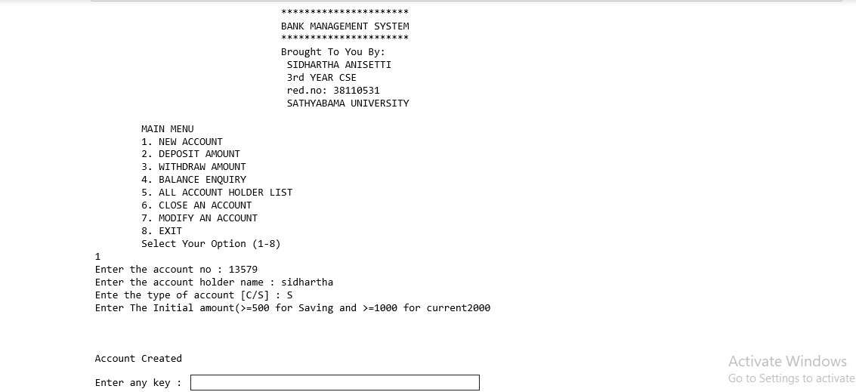
Application Snapshots
Introduction screen and Creating an account:

Slide 16
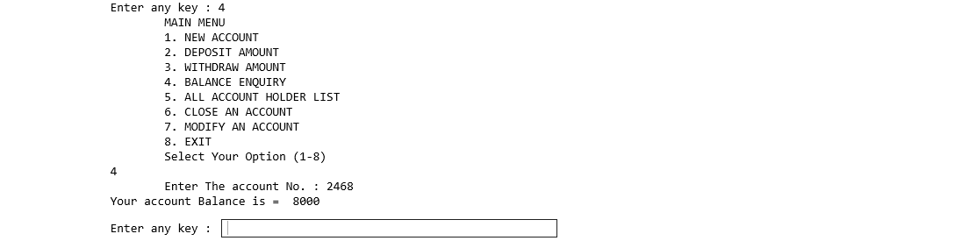
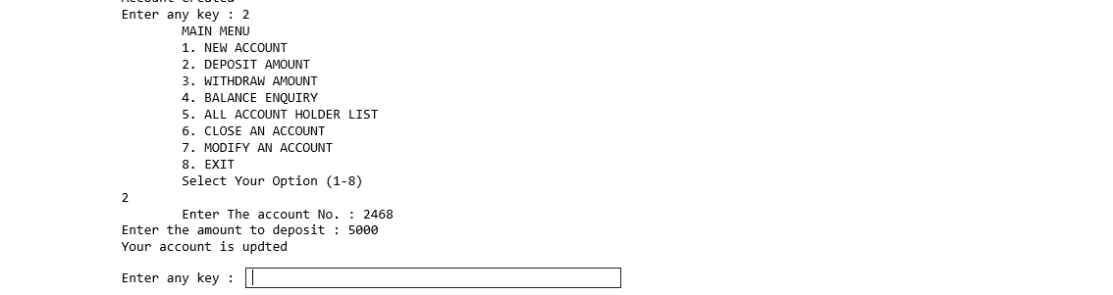
Displaying amount:
Depositing amount:

Slide 17
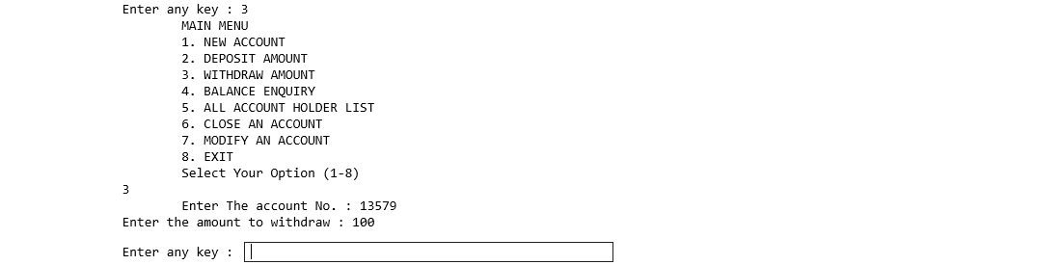
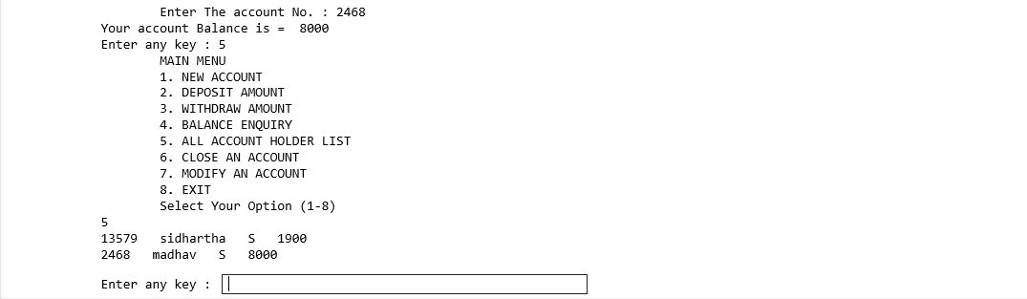
Withdrawing amount:
Account holder’s list:

Slide 18
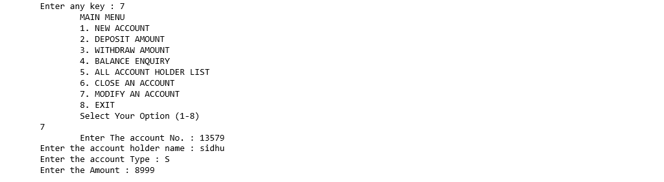
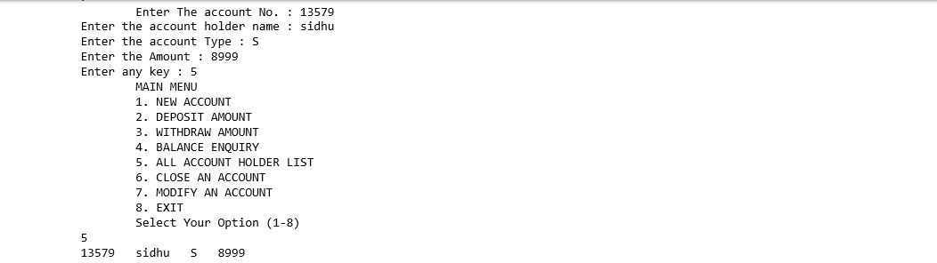
Modifying account:
Closing an account:

Slide 19
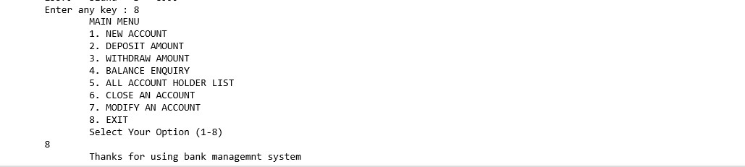
Exit

Slide 20
References
https://en.wikipedia.org/wiki/Bank
https://docs.python.org/3/library/pathlib.html
https://docs.python.org/3/library/os.html
https://docs.python.org/3/library/pickle.html
https://www.udemy.com/course/python-the-complete-python-developer-course

Slide 21


Slide 22

BANK MANAGEMENT SYSTEM
Questions & Answers

